Slide 1
Public Pension Issues and Trends
Keith Brainard
Research Director National Association of State Retirement Administrators
Presented to the
The Harris School at The University of Chicago
October 2023

Slide 2
Overview
Big Picture of Public Pension Plans
Funding
Investment Performance
Investment Return Assumptions
Contribution and Spending on Pensions
Challenging Labor Markets
Payroll Growth

Slide 3
Public pensions in the U.S.
$5.64 trillion in assets (6/30/23)
14.9 million active (working) participants
9.5 percent of the nation’s workforce
12.0 million retirees and their survivors receive $325 billion annually in benefits
Annual contributions = $283 billion
$221 billion from employers
$62 billion from employees
Of 4,600+ public retirement systems, the largest 75 account for 80+ percent of assets and members
Aggregate funding level = ~75%
US Census Bureau, Public Fund Survey

Slide 4
Public pensions in Illinois, 2022
~$200 billion in assets
563,000 active (working) participants
593,000 retirees and their survivors receive $19 billion annually in benefits
Annual contributions = $26 billion
$23 billion from employers
$3 billion from employees
24 public retirement systems*
Prior to 2022, there were more than 650 systems in Illinois. Consolidation in 2021 of public safety systems to two reduced the number.
US Census Bureau, Public Fund Survey

Slide 5
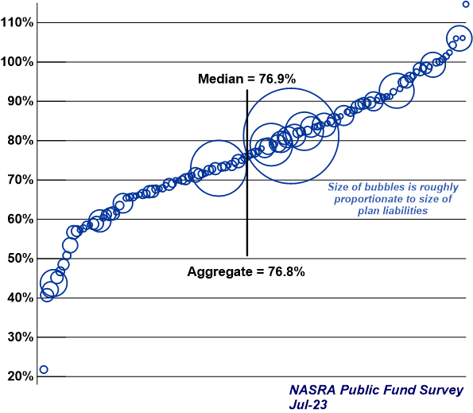
Distribution of Public Pension Funding Levels, FY 22
IMRF
Chicago TRS
IL SURS
IL TRS
IL SERS

Slide 6
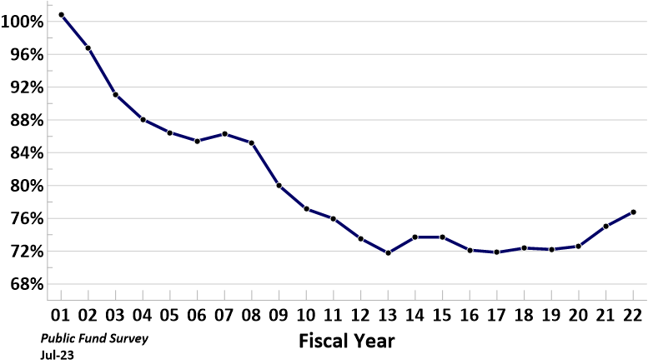
History of Aggregate Public Pension Funding Level FY 01 to FY 22
Phase-in
of 2000-02
market
losses
Reduced benefits; lower investment return assumptions;
higher contributions
Phase-in
of 2008-09
market
losses
Market
volatility;
surging
contributions

Slide 7
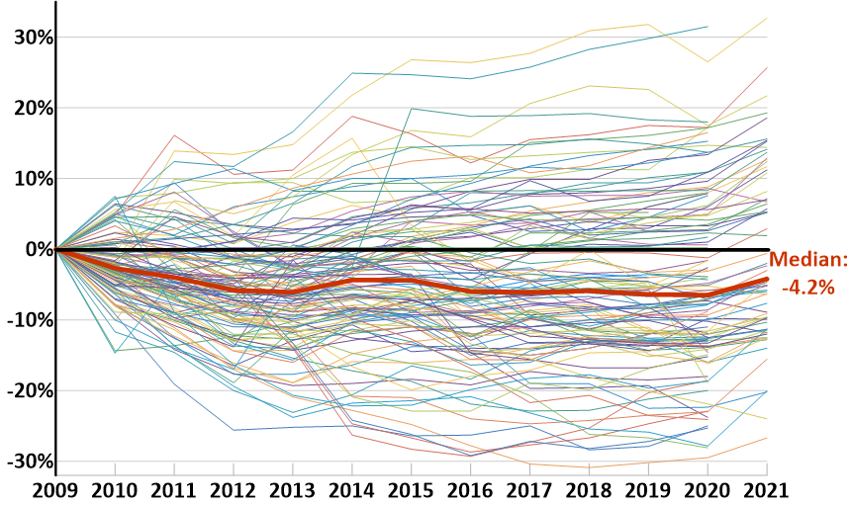
Distribution of Nominal Change in Actuarial Funding Level, FY 09 to FY 21 117 Plans

Slide 8
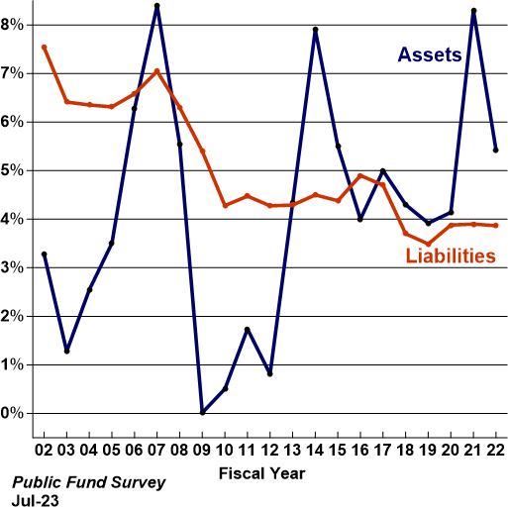
Median Annual Change in Combined Actuarial Assets and Liabilities

Slide 9
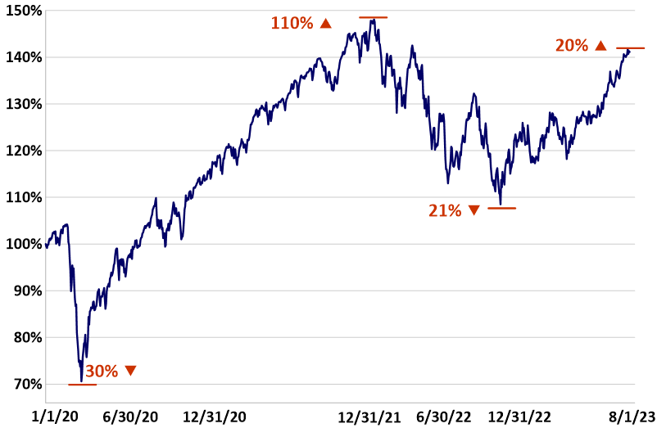
Pandemic-Induced Volatility: Relative Change in S&P 500 Since 1/1/20

Slide 10
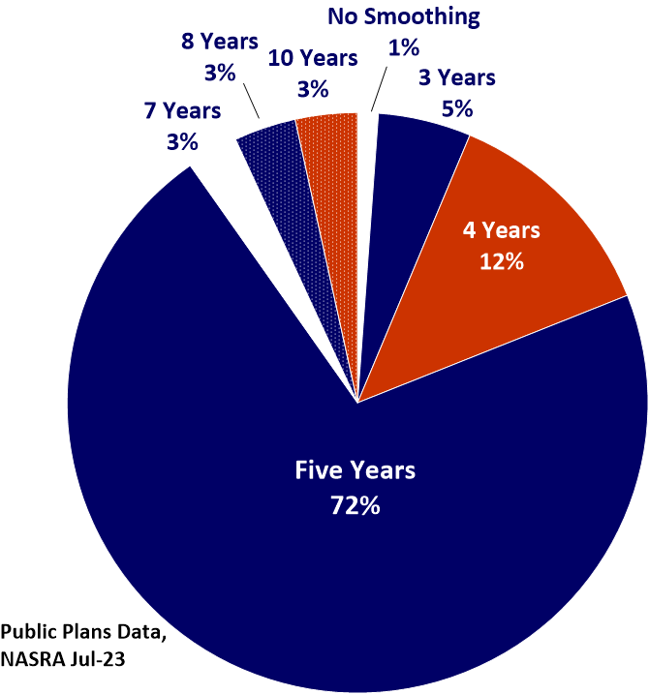
Distribution of Periods Used to Smooth Investment Gains and Losses
All large Illinois
plans use 5 years
except Chicago
TRS, at 4

Slide 11
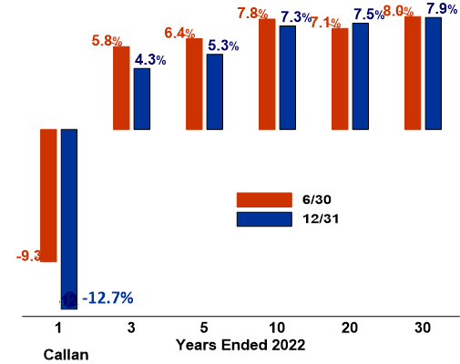
Median Public Pension Annualized Investment Returns for FY-end dates in 2022

Slide 12
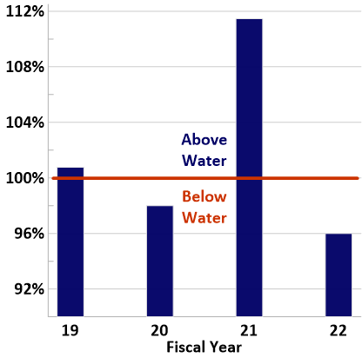
Average Market Value of Assets as a Percentage of Actuarial Value of Assets FY 19 to FY 22
Public Plans Data,
Public Fund Survey
Jul-23
123 plans

Slide 13
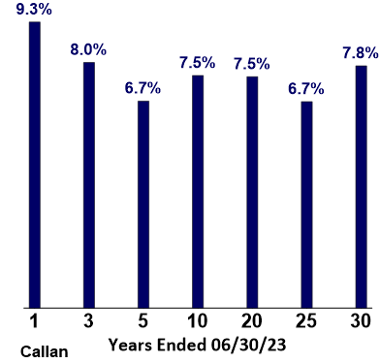
Median Annualized Public Pension Fund Investment Returns for Periods Ended 6/30/23

Slide 14
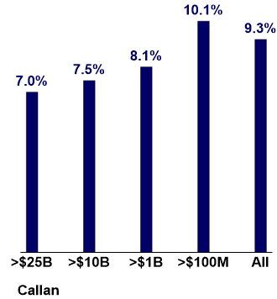
Median Public Pension Fund Investment Returns for the Year Ended 6/30/23 Based on Fund Size

Slide 15
Sources of Public Pension Revenue, FY 92 to FY 22

Slide 16
Change in median and average investment return assumption, FY 01 to present
IL SURS: 6.5%
Chicago TRS: 6.75%
IL SERS: 6.75%
IL TRS: 7.0%
IMRF: 7.25%

Slide 17
Distribution of Public Pension Investment Return Assumptions, August 2023
IL SURS: 6.5%
Chicago TRS: 6.75%
IL SERS: 6.75%
IL TRS: 7.0%
IMRF: 7.25%

Slide 18
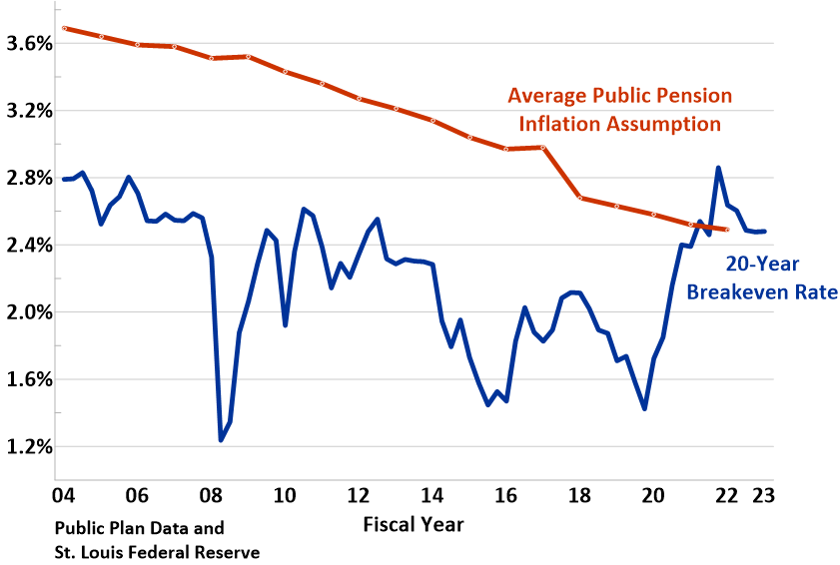
Average Public Pension Plan Inflation Assumption vs. 20-Year Breakeven Rate
The breakeven rate is a measure of expected inflation derived from 20-Year Treasury Constant Maturity Securities and 20-Year Treasury Inflation-Indexed Constant Maturity Securities. The latest value implies what market participants expect inflation to be in the next 20 years, on average.

Slide 19
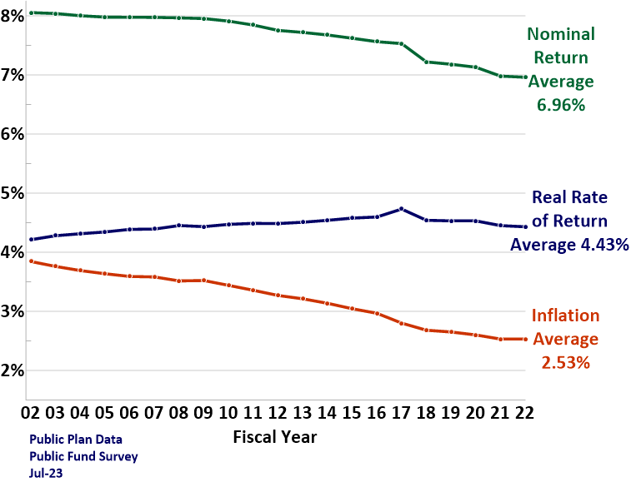
Change in Assumptions for Nominal and Real Rate of Return and Inflation
OCERS: 4.5%

Slide 20
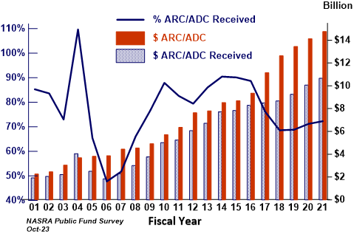
Annual Required Contribution/Actuarially Determined Contribution and Amounts Paid, Illinois Statewide Pension Plans, FY 01-FY21
Reflects combined experience of IL SERS, IL SURS, IL TRS and IMRF

Slide 21
Distribution of Contributions Paid as a Percentage of Actuarially Recommended Rates, by State, FY 01 to FY 21
IL
Public Fund Survey
Nov-22

Slide 22
Inflation-Adjusted Spending on Public Pensions by States & Local Government 1992 to 2021
Illinois FY 20: 10.6%

Slide 23
Spending on Pensions in Illinois in $ and as a % of All Spending
% spending reflects all public pensions in the state; $ spending
reflects IMRF, SERS, TRS, and SURS

Slide 24
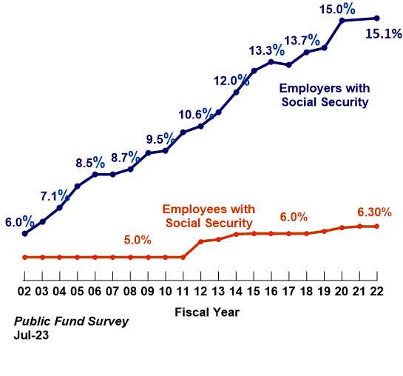
Median Contribution Rates Social Security-Eligible
FY 22 Rates
IMRF: 9.73%
SERS: 55.45%
IMRF: 4.5%
SERS: 4.0%
Contribution rates reflected here are those for general employees and public school teachers and predominantly exclude rates for public safety personnel

Slide 25
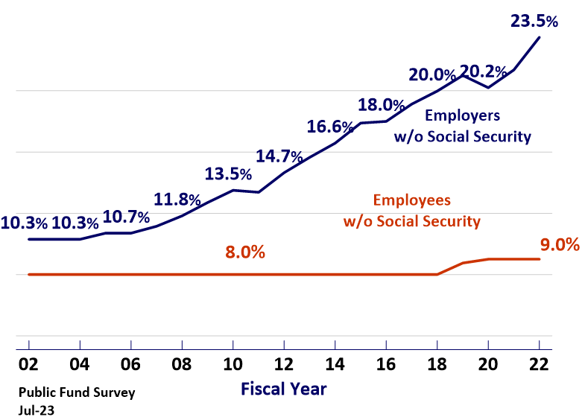
Median Contribution Rates Employee and Employer Social Security-Ineligible
FY 22 Rates
IL TRS: 51.4%
IL SURS: 59.12%
IL SERS: 8.0%
IL SURS: 8.0%
IL TRS: 9.0%
Contribution rates reflected here are those for general employees and public school teachers and predominantly exclude rates for public safety personnel

Slide 26
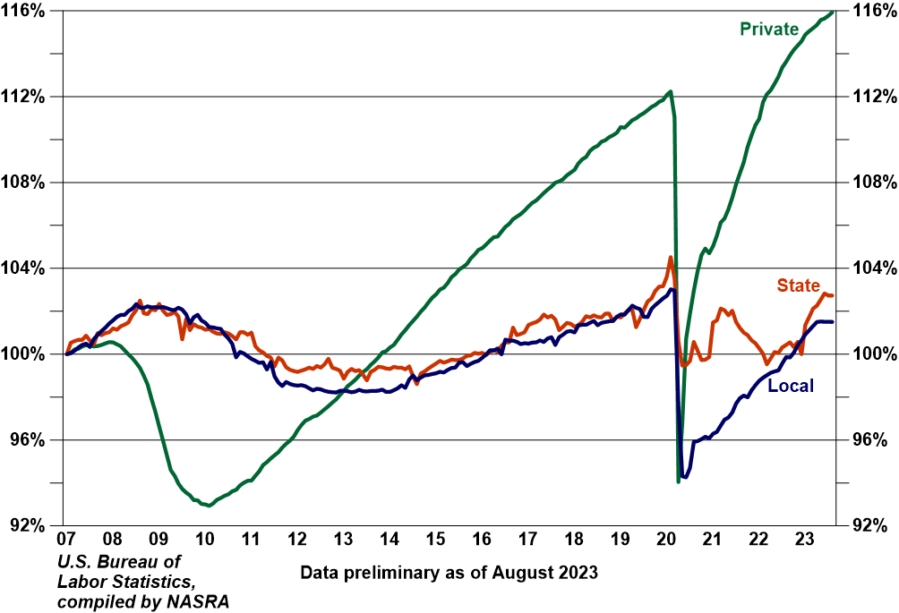
Relative Change in Private and State and Local Employment since 2007
U.S. Bureau of Labor Statistics

Slide 27
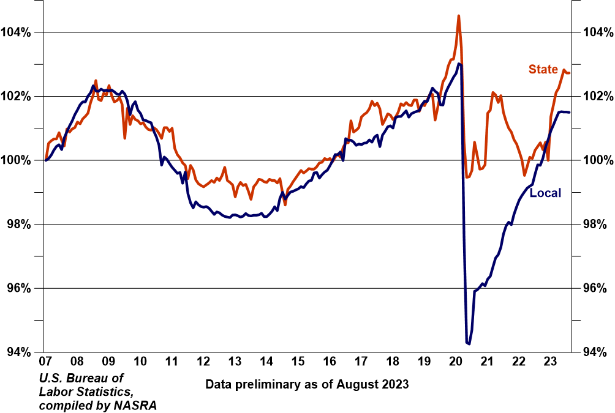
Relative Change in State and Local Employment since 2007
U.S. Bureau of Labor Statistics

Slide 28
Monthly change in general state and local government employment since 2007

Slide 29
Monthly change in state & local government education employment since 2007

Slide 30
US Labor Force Participation Rate, 1980 to present
St. Louis Federal Reserve Economic Data

Slide 31
Distribution of change in active participants, 2011-2020
IL SERS: -2.4%
IMRF: -3.1%
IL TRS: -3.6%
IL SURS: -7.7%
Chicago TRS: -11.4%
Public Plans Data

Slide 32
Median annual change in actives and annuitants
IL SERS: 0.79
IL SURS: 1.03
Chicago TRS: 1.13
IMRF: 1.17
IL TRS: 1.24
Notes:
Actives declined for first time since 2014
Growth in annuitants continues at a slower pace (3rd straight year of decline)

Slide 33
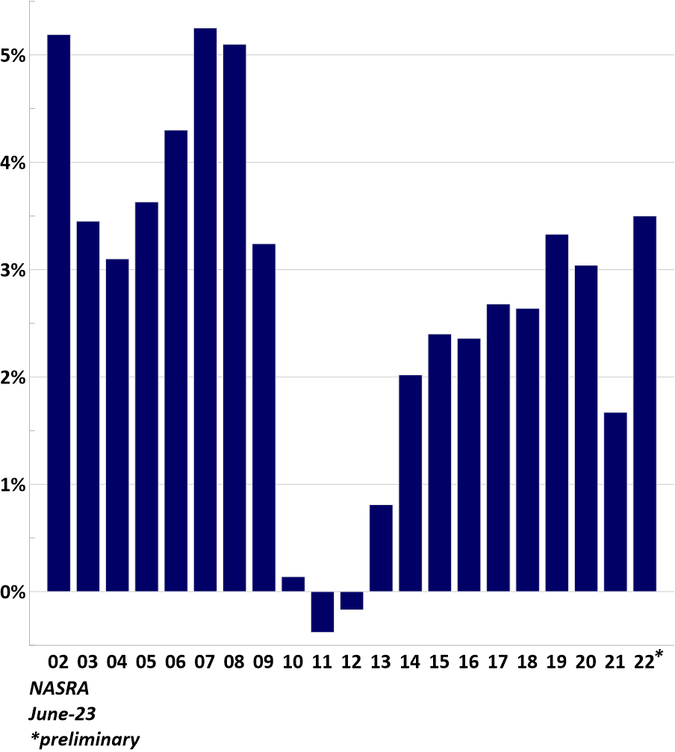
Median Annual Change in Public Pension Payrolls FY 02 to FY 22
Notes:
The number of workers employed and growth in their salaries are the key determinants of the growth of a public pension plan’s covered payroll base, which serves as its funding base since employer contributions are typically expressed as a percentage of covered payroll
The median growth in covered payroll declined in FY 21 for the second consecutive year, and much more sharply than it did in the year prior, falling to its lowest level since FY 13, when states and local governments were at the lowest point in their eventual recovery from the Great Recession
This decline comes after we were starting to see some evidence of accelerated payroll growth, with the median climbing above three percent in FY 19, just before the pandemic

Slide 34
Final Observations
Public pension plans face a challenging funding environment:
Capital market volatility and uncertainty
Inflation increases pressure on wages and liability growth
Slow growth in the rate of new hires pressures contribution rates as a percentage of payroll
Pandemic relief is over and near-term forecasts for economic activity are generally tepid

